Slide 1

Baseline Emission Inventories: how to build them?
Michele Sansoni
Arpa Environment Agency of Emilia-Romagna Region
michelesansoni@arpa.emr.it

Slide 2
Agenda
What we will see
  GHG Inventories: context and importance
  Key concepts for building a BEI
  Examples of calculation
  Planning an inventory: suggested phases
  List of references and supporting tools
What we will NOT see
  other emissions than GHG (e.g. PM, NOx)

Slide 3
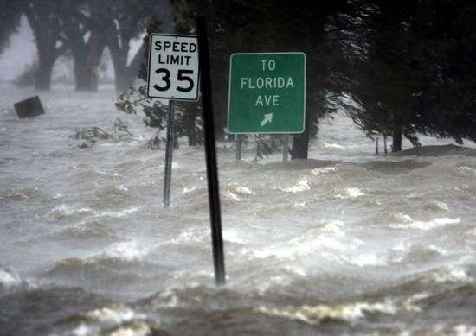





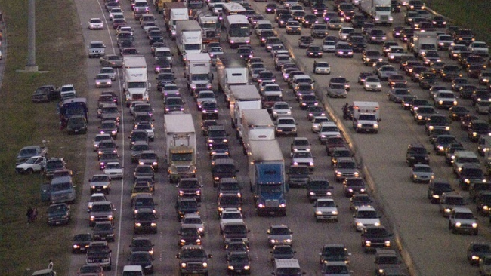
Context (DPSIR model)
S
I
State
(ppm GHG in Atmosphere)
Impact
(Climate Change)
P
Pressures
(GHG)
Adaptation
R
D
Drivers (Sources)
Responses
(SEAP and Climate Planning)
Mitigation

Slide 4

What is GHG Inventory?
An organised list of greenhouse gases (GHG)
  emitted in a territory (city, region, country…)
  occurred in a defined amount of time (day, year, …)
  from different sources (anthropogenic, natural)
  and related sectors (buildings, transportation, industries, …)
The Baseline Emission Inventory (BEI)
  quantifies the amount of CO2 (or GHG) emitted due to energy consumption in a territory of a local authority in the baseline year
  allows to identify the principal anthropogenic sources of CO2 emissions and to prioritise the reduction measures accordingly
SEAP Guidelines par. 2.2, p.56

Slide 5
Why a local inventory?
Climate change (CC) is a global problem…
  … but 80% of energy consumption and CO2 emissions is associated with urban activity: the fight against climate change will be won or lost in urban areas (CoM).
Local governments (LG) play a crucial role in mitigating effects of CC
  2007 EU reduction objective for GHG (-20% in comparison to1990 by 2020)
  2008 Covenant of Mayors for cities that commit to go beyond EU objective
  Europe‘s ambitious targets for cutting GHG will only be met when EU local and regional authorities pull together and become involved as partners
LG need to know their emission sources and reduction potentials
  for climate action planning, the BEI is not the end, but a means to the end

Slide 6
Why inventories are useful?
INFORMING
policymakers, stakeholders and citizens
KNOWING
the state of the environment, environmental priorities and critical issues of the territory
MONITORING
actions chosen to ensure that adopted strategies are effective in targeting objectives
SUPPORTING
planning through definition of objectives and actions
EVALUATING
effects of local plans/policies on the environment and (environmental) costs and benefits of different strategies

Slide 7

Key concepts
Baseline (year)
Boundaries of an inventory
Scope of emissions
GHG included in an inventory
GWP coefficients and CO2eq
Sectors (and plants)
How to quantify emissions
How to monitor progresses

Slide 8
Baseline and baseline year
GHG emissions (EU 27)
Baseline (1990)
Effect of Plan
Hystoric data
BAU scenario
(without Plan)
Baseline year is the year against which the achievements of the emission reductions in 2020 shall be compared
(SEAP Guidelines par. 2.1, p.56)
Plan scenario
Target
(-20%)

Slide 9


Boundaries of an inventory
Community emissions
SEAP Guidelines par. 2.2, p.56
Government (Corporate) emissions
“Geographical” boundaries
  administrative boundaries of the territory of the LG (e.g. urban road transportation: private and commercial transportation)
“Corporate” boundaries
  functions and facilities under direct/indirect control of the LG (e.g. urban road transportation: municipal fleet)

Slide 10
Scope of emissions
community
related to fuel combustion in the territory (buildings, transportation, …)
(e.g. GHG emissions from private transportation/from municipal fleet)
Direct emissions
scope 1
corporate
SEAP Guidelines par. 2.2, p.56
scope 2
community
related to production of electricity,
heat, or cold that are consumed in the territory regardless of the location of the production (e.g. GHG emissions from electricity consumptions in community/corporate)
Indirect emissions
corporate
scope 1
community
other direct emissions that occur in the territory not related to energy (agriculture, waste management, …) (e.g. CH4 emissions from enteric fermentation/landfill controlled by LG)
Other direct emissions
corporate

Slide 11
GHG included in an inventory
 | CO₂ | CH₄ | N₂O | F-gas (SF₆, HFC, PFC)
Energy (Combustion, Exploitation, Distribution, Processing)
Industrial Processes (Chemical reactions, fugitive emissions)
Waste (Landfills, Wastewater, Incineration)
Agriculture (Animals, Fertilizers, Land use)
GHG
Sectors
+++
+
+
+
+
++
+++
+
++
++
+
++
+++

Slide 12
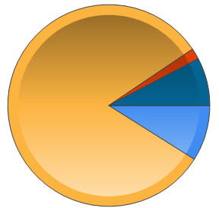
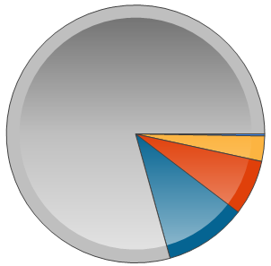
GHG emissions by gas and sector (EU27, 2009)
Carbon dioxide CO2
  the main contribution (82% of total)
Energy
  80% of total emissions
  includes energy industries, energy uses (commercial, residential), transports
CO2 81.6%
F gas 1,8%
N2O 7.7%
Energy 79.3%
CH4 9.0%
Solvents 0.2%
Waste 3.2%
Industrial Processes
7.0%
Agriculture 10.3%
Source: EEA greenhouse gas - data viewer (http://www.eea.europa.eu/data-and-maps/data/data-viewers/greenhouse-gases-viewer)

Slide 13
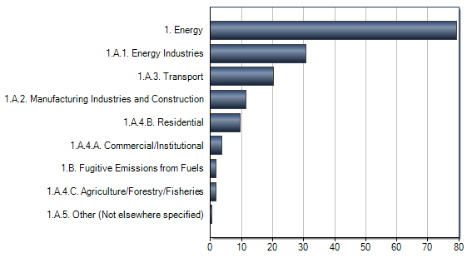
Contribution of energy sector (EU27, 2009)
79.3%
30.6%
20.2%
11.5%
9.6%
3.7%
Source: EEA greenhouse gas - data viewer (http://www.eea.europa.eu/data-and-maps/data/data-viewers/greenhouse-gases-viewer)

Slide 14
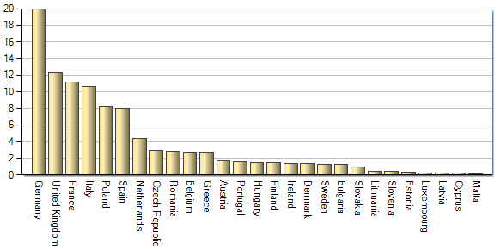
Emissions shares by country
(EU27, 2009 %)
DE 19.9%
920 M tonnes
Total EU27: 4614.5 M tonnes
Average EU27: 171 M tonnes
IT
10.6%
ES
8.0%
RO
2.8%
HU
1.4%
BG
1.3%
LV
0.2%
CY
0.2%
Fonte: EEA greenhouse gas - data viewer (http://www.eea.europa.eu/data-and-maps/data/data-viewers/greenhouse-gases-viewer)

Slide 15

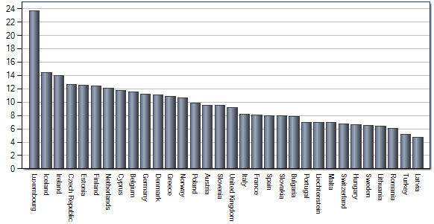

Emissions per capita
(EU27, 2009, tonnes)
LU
23.6 tonnes
Average EU27: 9.7 tonnes
CY
11.8 t
IT
8.2 t
ES
8.0 t
BG
7.8 t
HU
6.6 t
RO
6.0 t
LV
4.7 t
Fonte: EEA greenhouse gas - data viewer (http://www.eea.europa.eu/data-and-maps/data/data-viewers/greenhouse-gases-viewer)

Slide 16

Average CO2 per capita
from 1 (Latvia) to about 6 rhinos (or a whale - Luxembourg) per year
Don’t worry, I will reduce my GHG emissions
for other equivalencies see: Greenhouse Gas Equivalencies Calculator
http://www.epa.gov/cleanenergy/energy-resources/calculator.html#results

Slide 17
GWP coefficients and CO2e
GWP – Global Warming Potentials
  To measure different GHG coherently the reporting unit to be chosen is “CO2 equivalent emissions” (CO2e)
  CO2e is a standard unit that allow summing different quantities of different GHGs, taking into account their specific impact on global warming
  Standard GWP values for UNFCCC and Kyoto reporting are based on the IPCC SAR (Second Assessment Report)
1t CO2 | 1t CO2e
1t CH4 | 21t CO2e
1t N2O | 310t CO2e
1t SF6 | 23900t CO2e
1t HFC or PFC | Different gases with different GWP
SEAP Guidelines par. 3.2, p.60

Slide 18
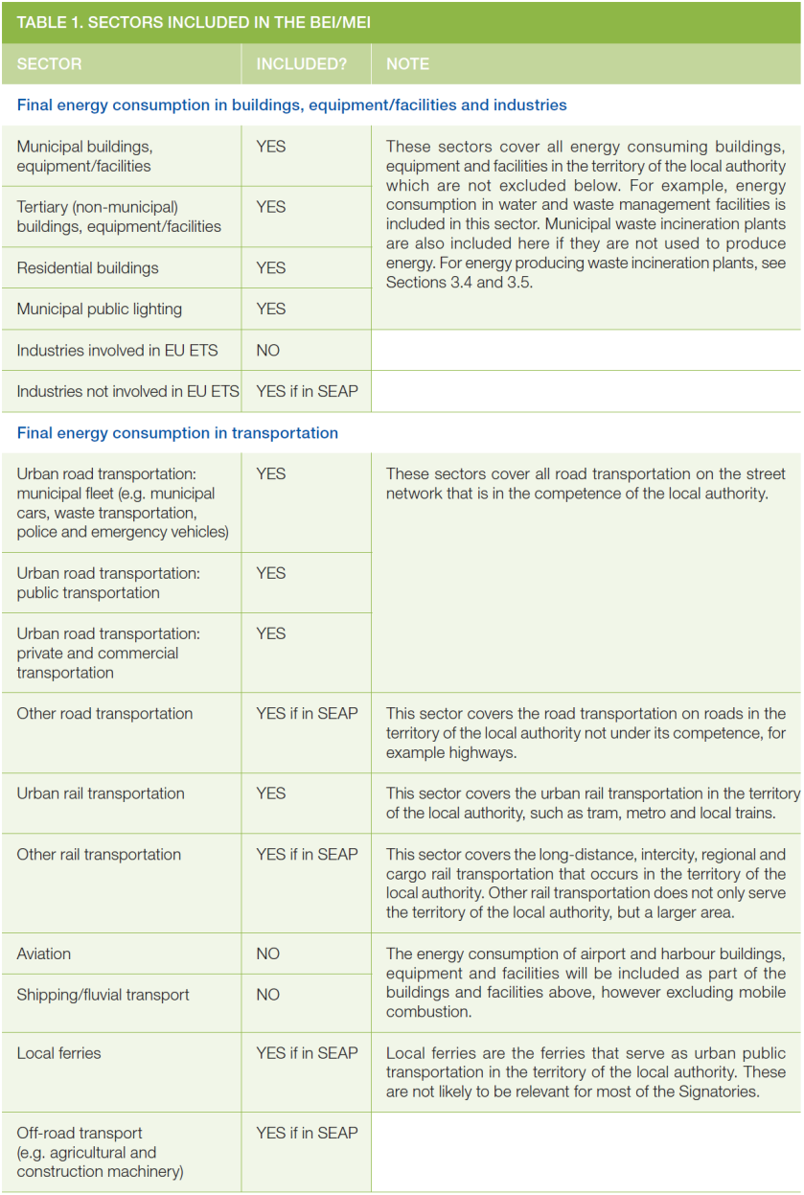
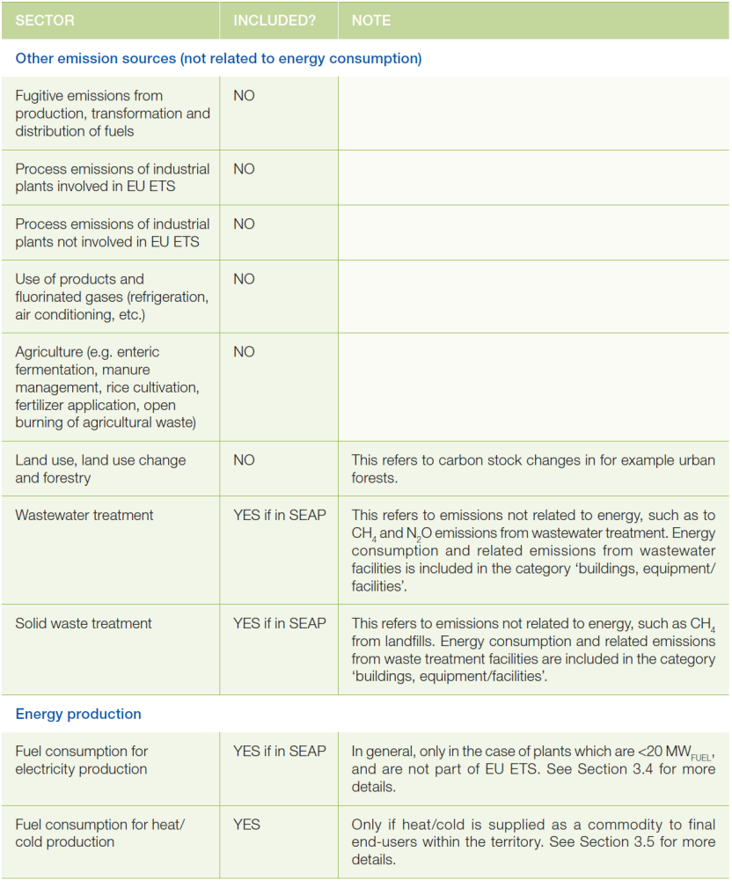
Sectors included in an inventory
SEAP Guidelines par. 2.2, p.57-58
YES: inclusion of sector in BEI/MEI is strongly recommended
YES if in SEAP: sector may be included if the SEAP includes measures for it (not mandatory but recommended to quantitatively show the emission reduction which took place as a result of measures)
NO: inclusion in BEI/MEI is not recommended

Slide 19
Sectors included in an inventory (buildings, equipment/facilities and industries)
SEAP Guidelines par. 2.2, p.57-58
Waste incineration here only if they do NOT produce energy
NO ETS Industries
YES other industries if in SEAP

Slide 20
Sectors included in an inventory (transportation)
SEAP Guidelines par. 2.2, p.57-58
Rail transportation
YES urban rail (tram, metro, …)
YES if in SEAP other rail (e.g. regional and long distance)
Airport and harbour
NO from mobile combustion
YES from buildings and facilities

Slide 21
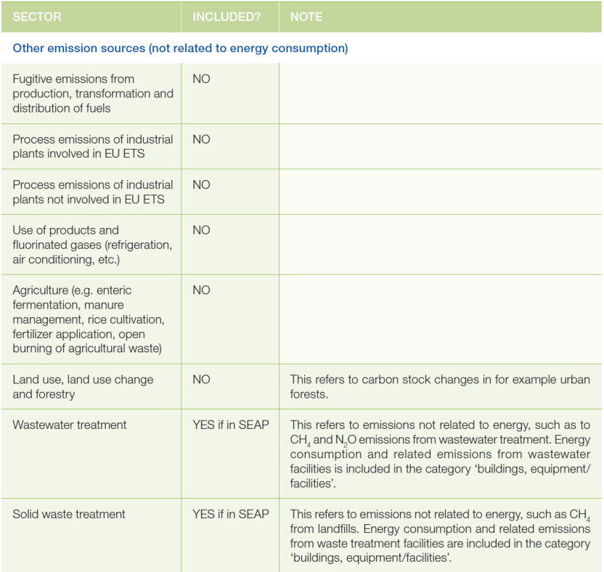
Sectors included in an inventory (other emission sources)
SEAP Guidelines par. 2.2, p.57-58
Other emissions sources
NO fugitive and process emissions
NO agriculture emissions (fermentation, manure management, fertilizers, …)
Wastewater and waste treatment
YES in in SEAP for emissions not related to energy (e.g. CH4 from landfills)

Slide 22
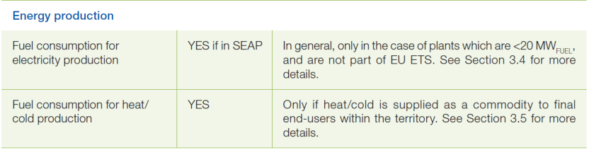
Energy plants included in an inventory
Focus of the CoM: demand (consumption) side
Local Electricity Production (LPE) concept and criteria for inclusion of plants:
  the plant/unit is not included in the EU Emissions Trading Scheme (ETS)
  the plant/unit is ≤ 20MW_{fuel} as thermal energy input in the case of fossil fuel and biomass combustion plants
  or ≤ 20MW_{e} as nominal output in the case of other renewable energy plants (e.g. wind or solar)
e.g. Waste incineration producing energy
YES if in SEAP for electricity
YES for heat/cold

Slide 23
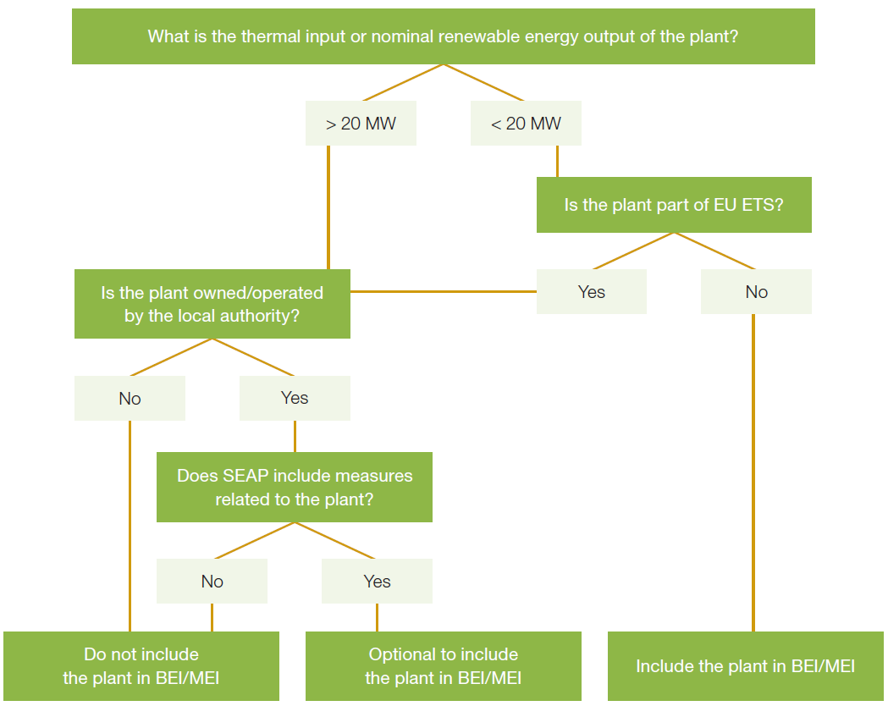
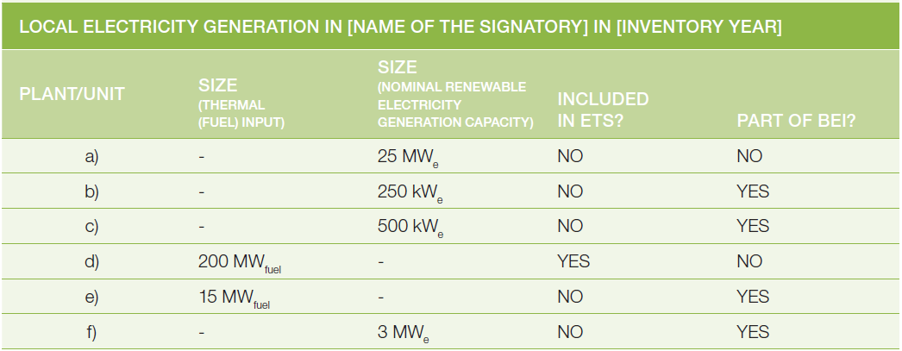
Decision tree and identification table
1
1a
1b
2

Slide 24
Sectors included (sample report)
Sector
Emissions
(tCO2e)
Municipality emissions usually have a little weight on total emissions
Residential
1.004.310
Tertiary
669.540
12%
3%
15%
Industry
2.031.343
5%
10%
Transport
1.619.189
Waste
320.856
Energy Production
827.276
24%
224.236
31%
Municipality
Residential
Tertiary
Industry
Transport
Waste
Energy Production
Municipality

Slide 25
How to quantify emissions
It is necessary to estimate emissions on the basis of a relation between an activity indicator of the source and the emission itself -> emission factor
FEi – emission factor
coefficient which
quantify the emission of gas “i” per unit of activity A (e.g. tonCO2/MWh; tonCO2/m3; tonCO2/litre)
Ei – emission
of gas “i”(tons/year), i.e. the quantity of gas “i” (in tons) generated and emitted by a given activity (e.g. tons of CO2/year from energy production)
Ei = A x FEi
A – activity indicator
describes the activity that emits GHG. e.g. unit of energy used for energy production (MWh/year; m3/year; litre/year)

Slide 26
Emission factors
Standard
  in line with the IPCC principles, cover all CO2e from energy consumption (direct and indirect emissions)
  based on the carbon content of each fuel, like in GHG national inventories (UNFCCC and Kyoto protocol)
  emissions from renewable energy = 0
LCA (Life Cycle Analysis)
  take into consideration the overall life cycle of the energy carrier from supply chain (exploitation, transport, processing…) to final combustion
  emissions from renewable energy > 0
SEAP Guidelines par. 3.1, p.59-60

Slide 27
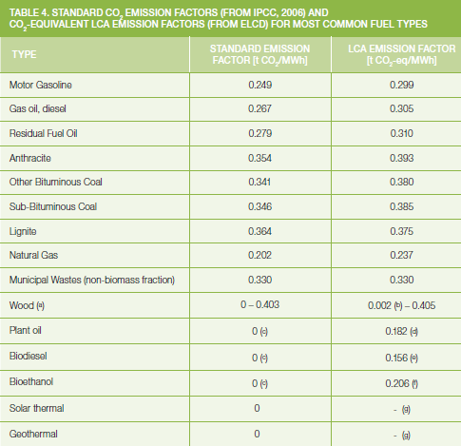
Emission factors for fuels
LCA E.F. are higher
(life cycle)
LCA E.F. for renewables > 0
SEAP Guidelines par. 3.1, p.62-63 and Annex I p. 82-83

Slide 28
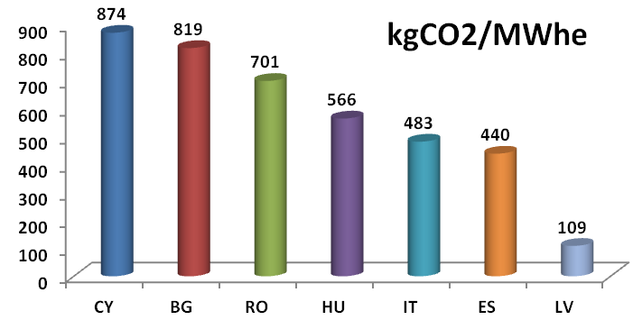
Emission factors for consumed electricity
CO2 from EU or national generation of electricity
Energy mix used (yearly)
Calculation of local EF
SEAP Guidelines par. 3.4.1, p. 63; 3.44 p. 66

Slide 29

Calculation with EF: examples
Emissions from municipal buildings (Italy)
Activity data (energy consumptions)
A_{electr}=200 MWh electricity
A_{natgas}= 30,000 m3 natural gas;
A_{gasoil}= 20 tons of gasoil
Find EF:
EF_{electricity}= 0.483 tCO2/MWh
EF_{natgas}= 0.202 tCO2/MWh
EF_{gasoil}= 0.267 tCO2/MWh
Quantify emissions (E=A*EF)
E_{electr}=A_{electr}*EF_{electr} = 200 * 0.483 =96.6 tCO2
E_{electr}=A_{natgas}*EF_{natgas} = 291 * 0.202 =58.8 tCO2
E_{electr}=A_{gasoil}*EF_{gasoil} = 230 * 0.267 =61.4 tCO2
Convert fuels in MWh
30,000 m3 natural gas -> 291 MWh
20 tons of gasoil-> 230 MWh
n.b. calculations are easy, but we should pay attention to different units of measure and different EF (see SEAP Guidelines Annex I p. 82)

Slide 30
Top-down TD vs. Bottom-up BU
Top-down
  estimation less accurate
  local data not available or final use do not justify survey of detailed data
  budget constraints: cost to collect data is too high
  time constraints: time required for data collection not compatible with deadlines
Bottom-up
  estimation more accurate
  high level of resources required (time, cost, people) to collect data
TOP-DOWN (TD)
(from a larger spatial scale to a local scale with a scaling factor –> scale down)
often both used in the same BEI
BOTTOM-UP (BU)
(from a single emission or subset to a local scale -> scale up or summation)

Slide 31
TD and BU methodology
To obtain activity data at local level (starting from known data at larger or smaller level) scaling factors are needed (chosen for their high degree of correlation to variations in activity data)
FACTOR_{y}
________
DATA_{y} =
* DATA_{x}
FACTOR_{x}
data at larger/smaller level
we must know
data at local level
we must estimate
scaling factors we must know (related to both data)

Slide 32
Top-down example
TD: scaling down residential energy consumption in the region to obtain residential consumption in the city
  Data_{y}: residential energy consumption in the city -> RES_{city} = ?
  Data_{x}: residential energy consumption in the region -> RES_{region}= 20,000,000 MWh
  Factor_{y}: population in the city POP_{city} = 300,000 inhabitants
  Factor_{x}: population in the region POP_{region} = 3,000,000 inhabitants
RES_{city}= POP_{city}/POP_{region} * RES_{region}
RES_{city} = 300,000/3,000,000 * 20,000,000
RES_{city} = 1/10 * 20,000,000
RES_{city} = 2,000,000 MWh
n.b. other possible scaling factor is volume of buildings

Slide 33
Bottom-up example
BU: scaling up residential consumption from a survey upon a sample set of buildings to obtain residential consumption in the city
  Data_{y}: residential energy consumption in the city -> RES_{city} = ?
  Data_{x}: resid. energy consumption in the sample set -> RES_{sample}= 35,000 MWh
  Factor_{y}: population in the city POP_{city} = 300,000 inhabitants
  Factor_{x}: population in the sample set POP_{sample} = 6,000 inhabitants
RES_{city}= POP_{city}/POP_{sample} * RES_{sample}
RES_{city} = 300,000/6,000 * 35,000
RES_{city} = 50 * 35,000
RES_{city} = 1,750,000 MWh
n.b. results from TD and BU are different, but they should have the same order of magnitude

Slide 34
Tiers
International guidelines (e.g. IPCC) identify 3 possible levels of methodological complexity (“tiers”)
  hierarchical structure
  higher tier methods are generally considered to be more accurate (in terms of methodology, activity data A and/or emission factors EF)
SIMPLICITY
Tier 1
the simplest (less accurate), readily available statistical information for A and standard values of EF
Tier 2
similar to tier 1 (more accuracy), but based on country-specific (or local) EF
Tier 3
facility level data and/or complex models to calculate emissions, but high accuracy
ACCURACY

Slide 35
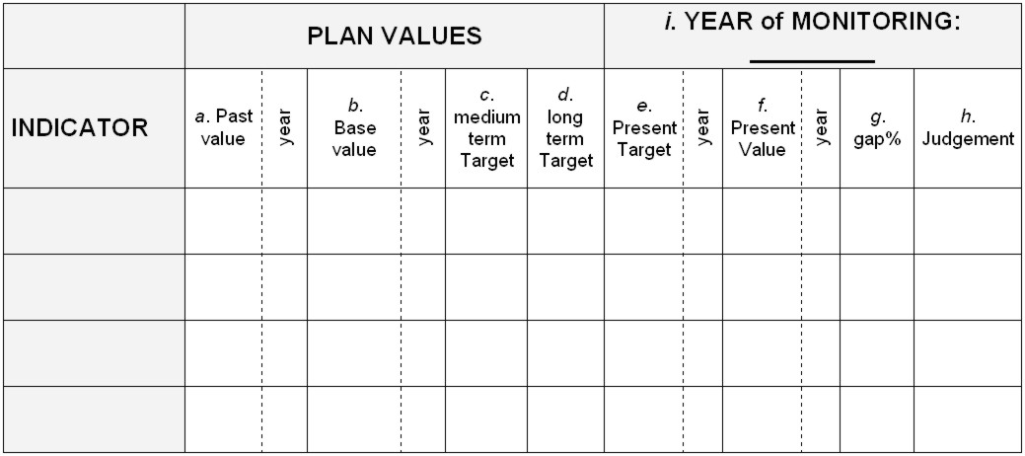

How to monitor progresses
a
b
d
f
g
GHG
g
b
f
a
d
time

Slide 36

Planning an inventory: suggested phases
Planning
Data collection
Elaboration and Control
Adapted from: “Phases for preparing an inventory”, ANPA 2001 (in italian) and SEAP Guidelines

Slide 37
Planning activities
Existing inventories
Tools and methodologies
Time
Staff
Define objectives
Available resources
Baseline
Boundaries
Gases
Sectors
Methodological approaches
Monitoring
Planning actvities
Identification of needed data
Procedure for data collection
Identification of emission sources
Procedure for emission calculation/estimation

Slide 38
Data collection
Data collection
Data sources (energy suppliers, consumers, national/regional statistics)
Activity indicators
Emission factors (standard, LCA)
Scaling factors for TD and BU (proxy variables)

Slide 39
Elaboration and Control
Elaboration and Control
REPORTING and PUBLICATION of RESULTS
(basis for SEAP planning activities and for next MEI)
EMISSION CALCULATION
Quality Assurance and Quality Control

Slide 40
Supporting tools and methodologies to build a BEI
BALANCE project (Ecofys in the framework of BALANCE)
Bilan carbone (ADEME)
California Climate Action Registry Project Protocols
DESGEL program energetic diagnostic and climate change emissions accountability (Barcelona Provincial Council)
ECO2Region (Climate Alliance)
Global Protocol for Community-Scale GHG Emissions – GPC (C40 Cities Climate Leadership Group and ICLEI in collaboration with: World Resources Institute, World Bank, UNEP, and UN-HABITAT)
GRIP tool (Tyndall centre Manchester)
INEMAR (Inventario Emissioni Aria - Regione Lombardia e Regioni Bacino Padano)
International Local Government GHG emission Analysis Protocol (ICLEI)
LAKS Inventory tool (Local Accountability for Kyoto Goals Life+ project) www.municipio.re.it/laks
Local and regional CO2 emissions estimates for 2005-2009 for the UK (Dept of Energy and Climate Change)
Local Government Operations Protocol For the quantification and reporting of greenhouse gas emissions inventories (California Air Resources Board, California Climate Action Registry, ICLEI, The Climate Registry)
The “CO2 Grobbilanz” and the “EMSIG” tool (Klimabündnis Österreich, Energieagentur der Regionen)
The CO2 Calculator (Danish National Environmental Research Institute, Local Government Denmark and COWI)
The Greenhouse Gas Protocol: A Corporate Accounting and Reporting Standard (World Business Council for Sustainable Development and World Resources Institute )
The Greenhouse Gas Protocol: The GHG Protocol for Project Accounting (WRI/WBCSD)

Slide 41
Suggestions for further reading…
ARPA (2009) International review - Tools and methodologies for GHG accounting. http://www.municipio.re.it/sottositi/Laks.nsf/PESIdDoc/450302B1A306EBEBC12575E80059FE39/$file/report_arpa_international_review.pdf
Bader and Bleischwitz (2009) Comparative analysis of local GHG inventory tools. http://www.municipio.re.it/sottositi/Laks.nsf/PESIdDoc/450302B1A306EBEBC12575E80059FE39/$file/GHG_inventories_report.pdf
EEA (2009) EMEP/EEA air pollutant emission inventory guidebook 2009. www.eea.europa.eu/publications/emep-eea-emission-inventory-guidebook-2009
ICLEI (2009) International Local Government GHG Emissions Analysis Protocol. www.iclei.org/ghgprotocol
ICLEI (2012) Global Protocol for Community-Scale GHG Emissions – GPC. www.ghgprotocol.org/city-accounting
IPCC (2006) Guidelines for national greenhouse gas inventories. www.ipcc-nggip.iges.or.jp/public/2006gl/index.html
ISPRA (2010) National Inventory Report 2010 - Italian GHG Inventory 1990-2008. http://unfccc.int/files/national_reports/annex_i_ghg_inventories/national_inventories_submissions/application/zip/ita-2010-nir-22jul.zip
JRC (2010) How to Develop a Sustainable Energy Action Plan (SEAP). www.eumayors.eu/IMG/pdf/seap_guidelines_en-2.pdf
JRC (2009) Methodologies and tools for the development and implementation of SEAPs. www.eumayors.eu/IMG/pdf/001_Report_I.pdf

Slide 42
Conclusions
YOU CAN build a BEI
  although at first it seems impossible …
  robust methodologies and supporting tools exist
  cooperation is fundamental (supporting structures, universities, public and private agencies)
ORGANISATION is the key
  develop process and procedures
  team work (different data, different persons involved)
  continuous improvement
BEI is the basis for achieving a wider planning process
  SEAP and Monitoring Emission Inventory (of course)
  Energy management (energy saving -> emissions reductions-> money saving)
  Energy Planning, Climate Change Planning (Adaptation)

Slide 43

Thank you for your attention
Michele Sansoni
michelesansoni@arpa.emr.it

